Slide 1
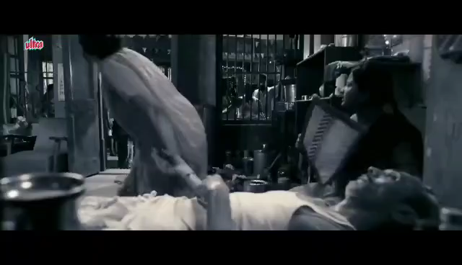

Slide 2
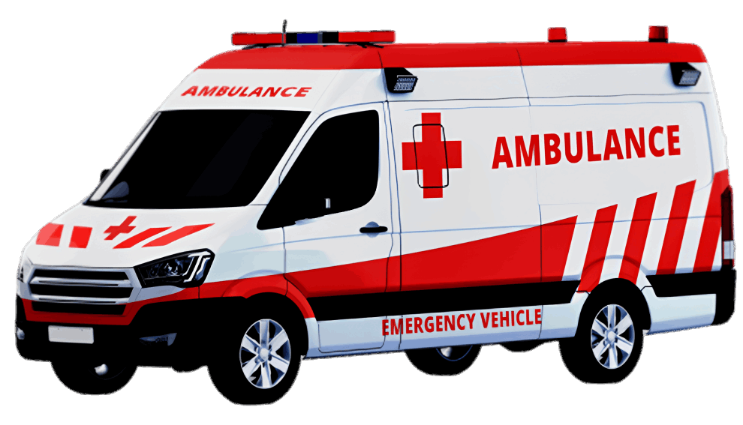
Jevan
Rakshak

Slide 3

Team Introduction
TEAM LEADER NAME: Parmeswar Nath Yadav
TEAM MEMBERS: Mithun M Achary
Priyanka Sharma
Jay Rathod
TEAM NAME: MASTERMIND

Slide 4

Problem Statement
Ambulance tracking systems play a crucial role in emergency medical services, ensuring timely and efficient response to life-threatening situations.
The existing ambulance tracking system lacks an efficient dispatch mechanism, resulting in delayed response times and suboptimal allocation of resources . This leads to critical delays in reaching emergency situations and can impact patient outcomes.

Slide 5

Solution
Jevan Rakshak is going to have below mentioned features to solve the existing problem:
User friendly
Real time tracking
Will connect you to nearby hospitals.
Emergency Alerts.
Cross Application

Slide 6
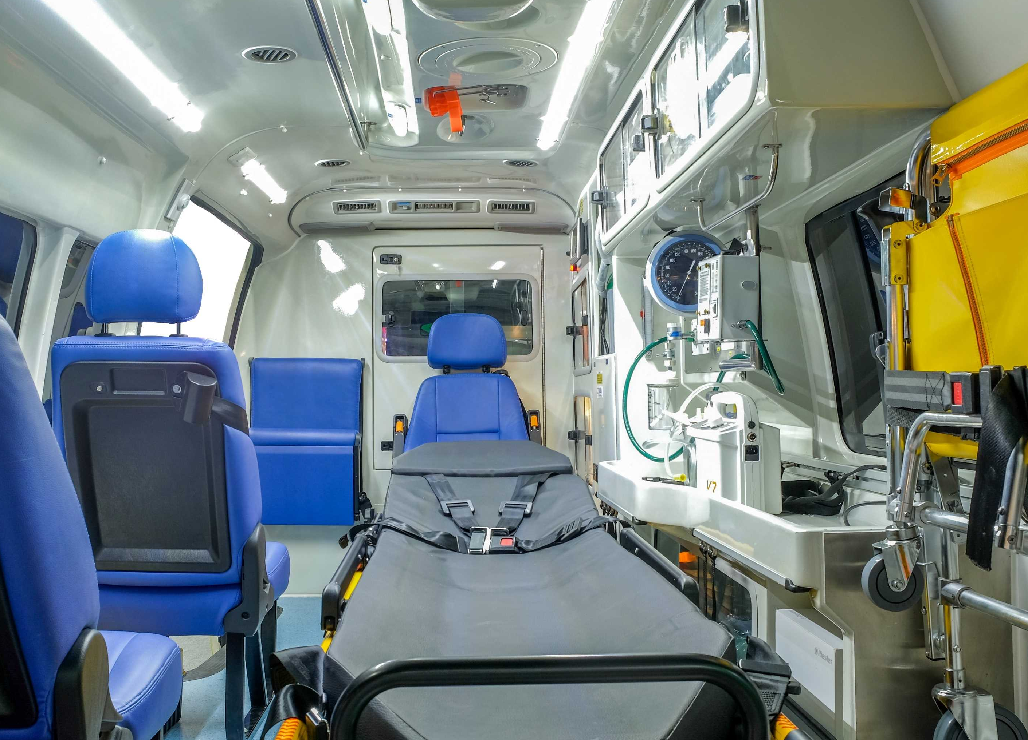
Technologies:
Flutter
Firebase
Code Editor:
VS Code
Android Studio
Technologies and code editor

Slide 7
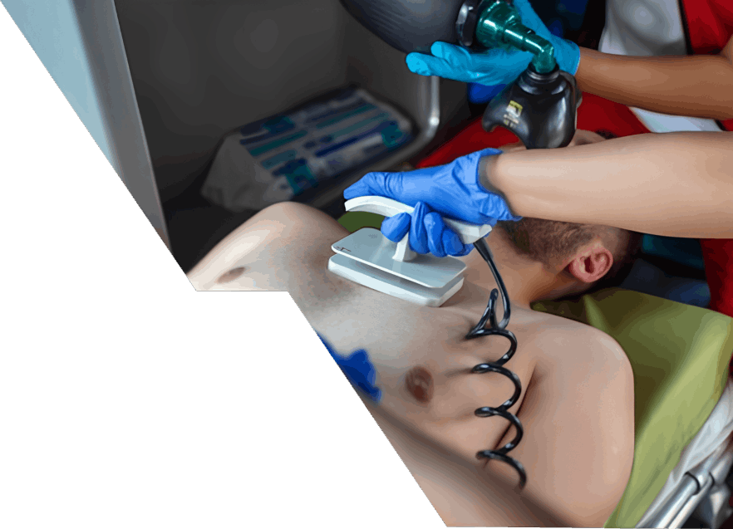
PRODUCT USP
User-Friendly Interface and Training Support: Our product features an intuitive user interface that is easy to navigate and understand. We also provide comprehensive training and ongoing support to ensure that users can effectively utilize the product's features and maximize its benefits.
Seamless Communication and Coordination: Our product facilitates seamless communication and coordination between dispatchers, ambulance crews, and hospitals through a secure and integrated platform. This enables real-time information exchange, enhancing the efficiency of patient care and handoff processes.

Slide 8
SWOT ANALYSIS
Competition
Human Nature
Regulatory Compliances
User Friendly
No paper works
Efficient
Real time tracking
Cross
Application
Technical limitations
Initial cost
Traffic
Provides Employment
Integration with hospital system
STRENGTH
WEAKNESS
OPPORTUNITIES
THREATS

Slide 9
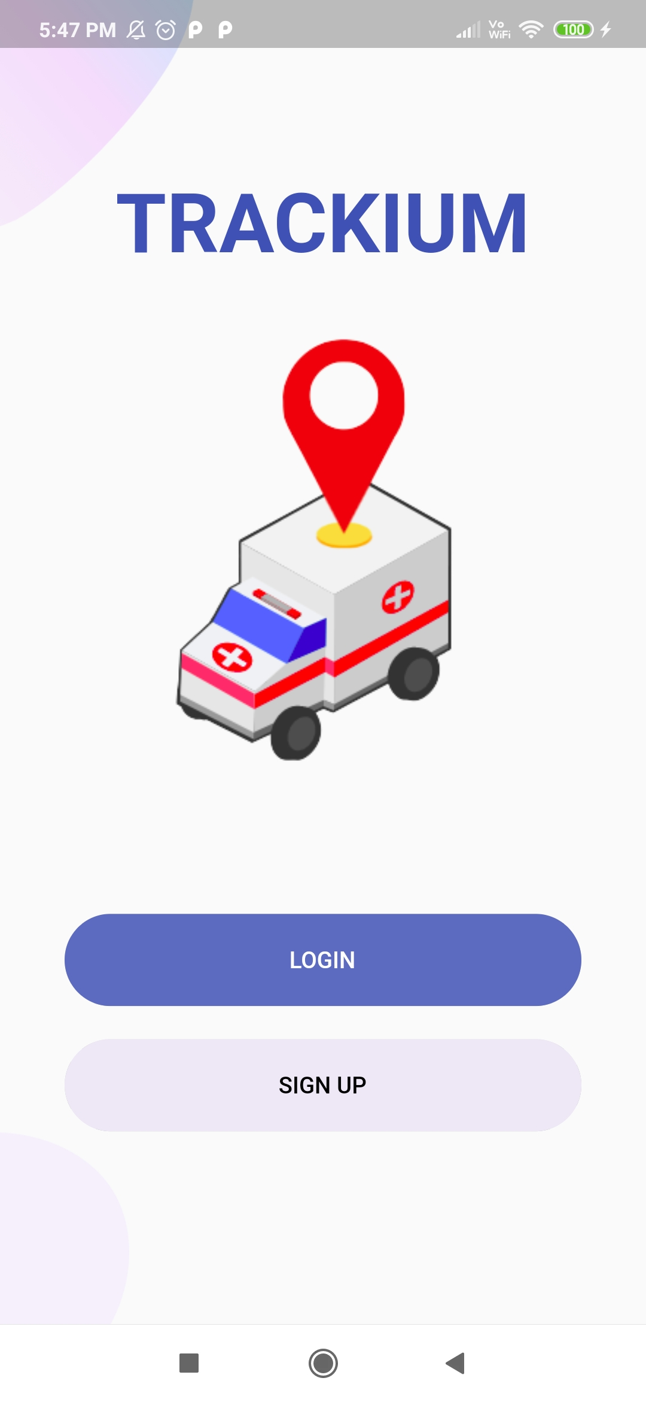

Slide 10
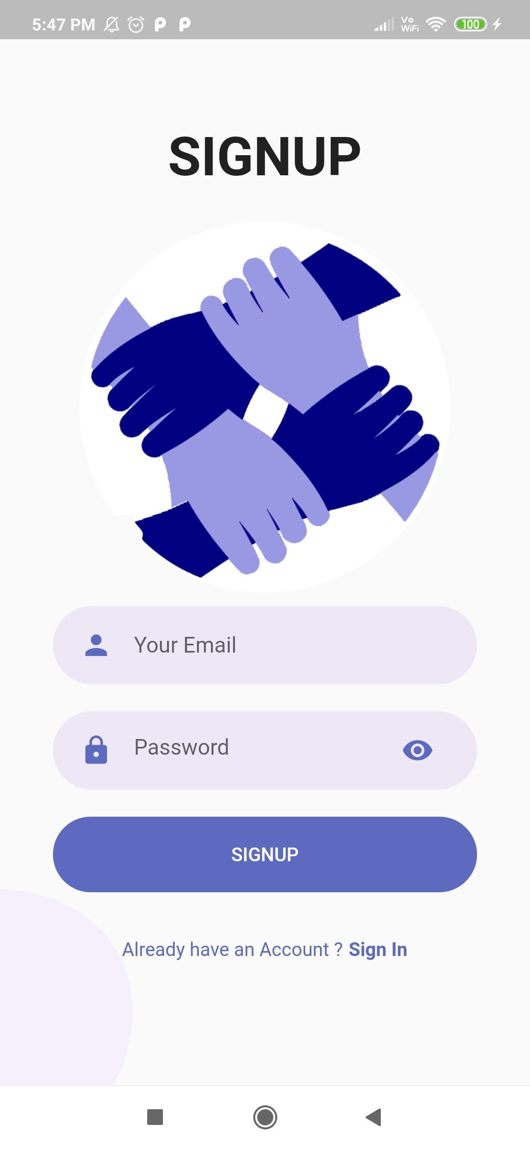

Slide 11
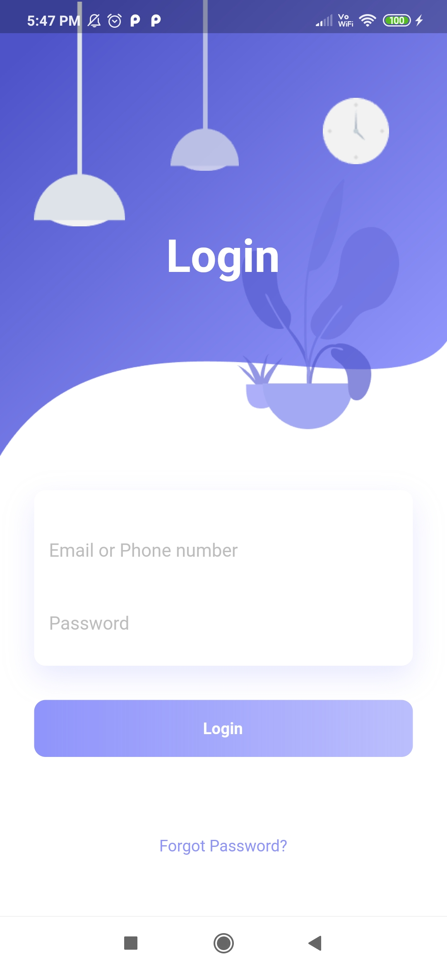

Slide 12
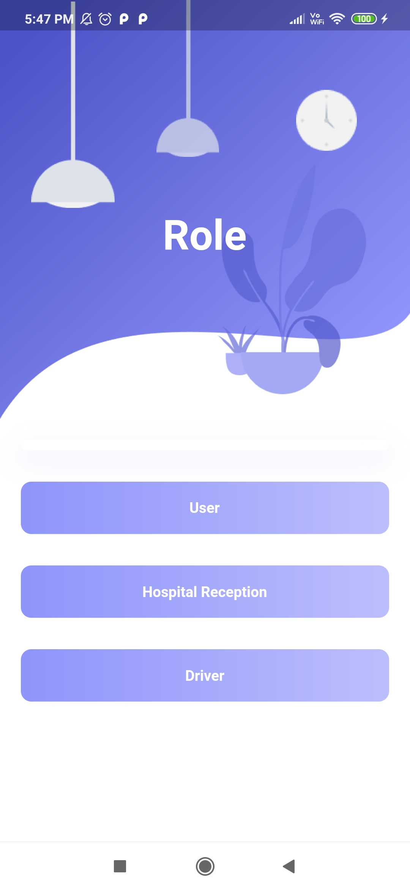

Slide 13
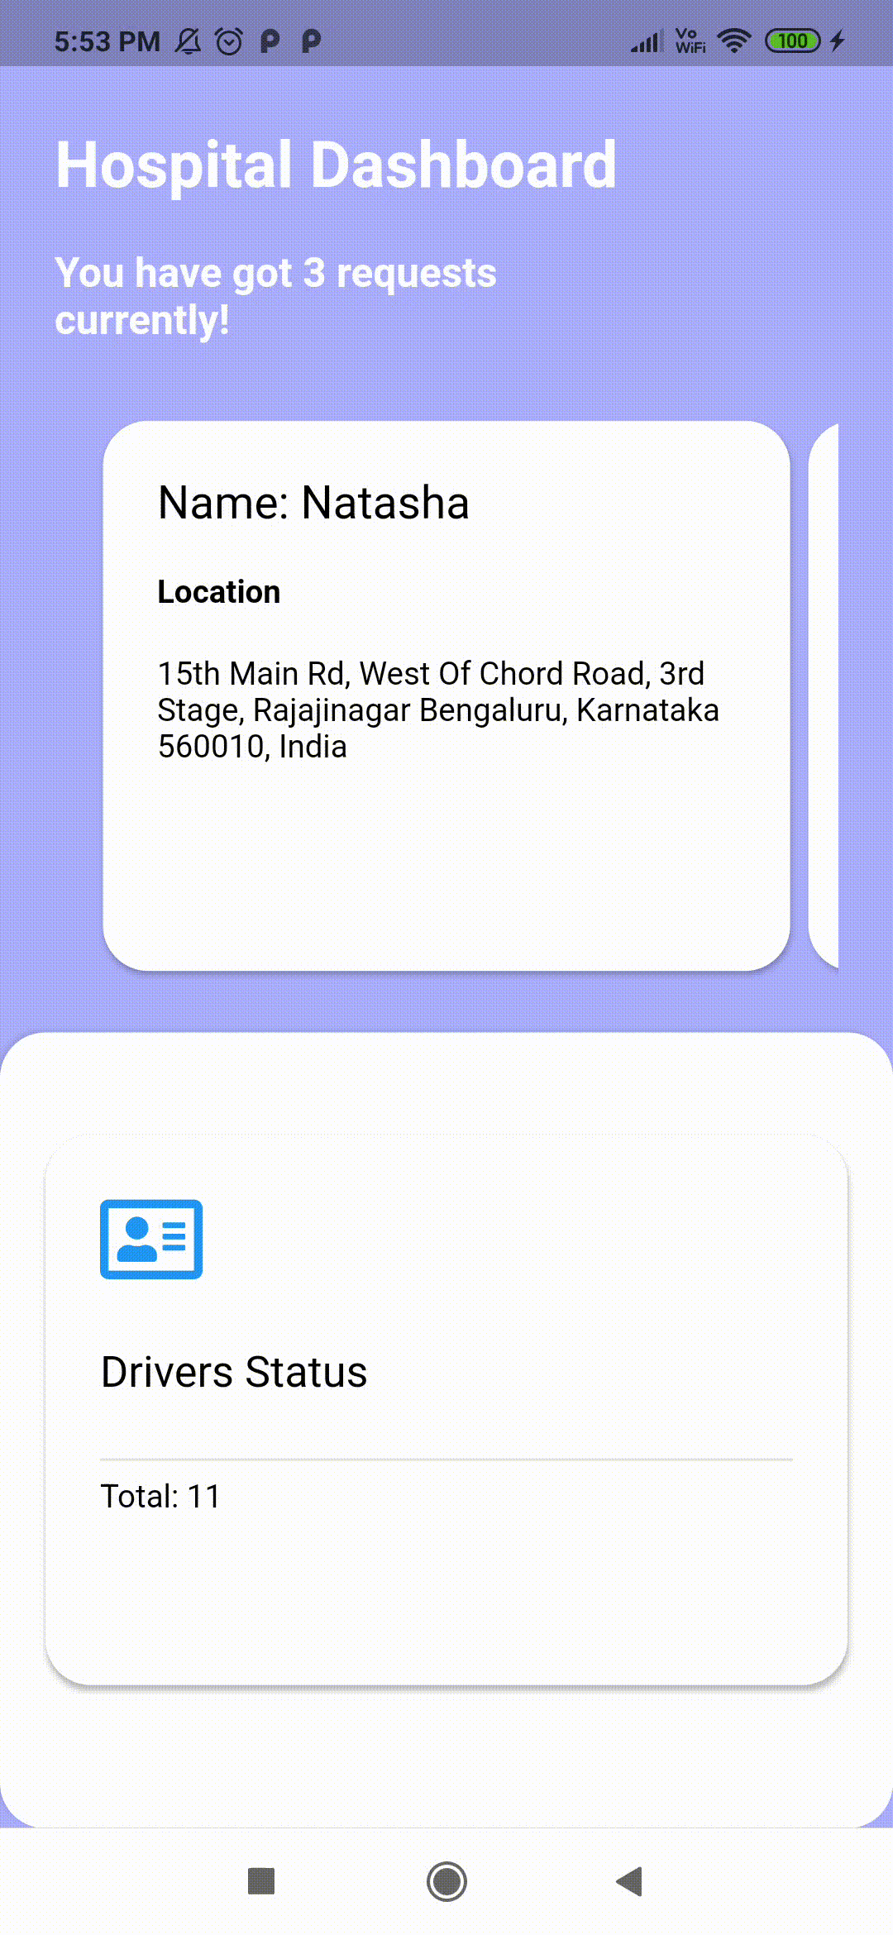

Slide 14
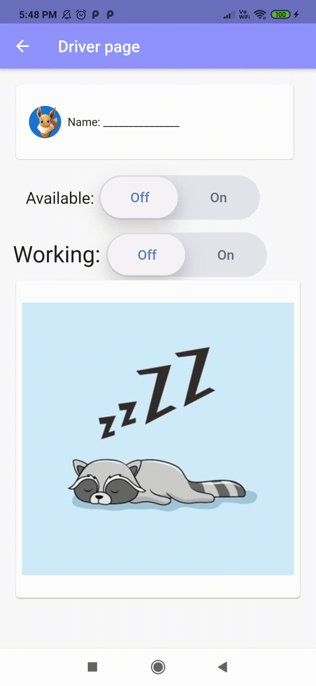

Slide 15
Thank You!
,

